Slide 1

4
INTEGRALS

Slide 2
Contents
4.1 Areas and Distance
4.2 The Define Integral
4.3 Evaluating Define Integrals
4.4 The Fundamental Theorem of Calculus
4.5 The Substitution Rule

Slide 3
INTEGRALS
4.1
Areas and Distances
In this section, we will learn that:
We get the same special type of limit in trying to find
the area under a curve or a distance traveled.
Notes:
Area under a curve as the limit of a sum areas of thin rectangles.
Distance in terms of the velocity curve.
Notation of Riemann Sum.
Approximation of areas using rectangles (the right hand, left hand and midpoint sums).

Slide 4
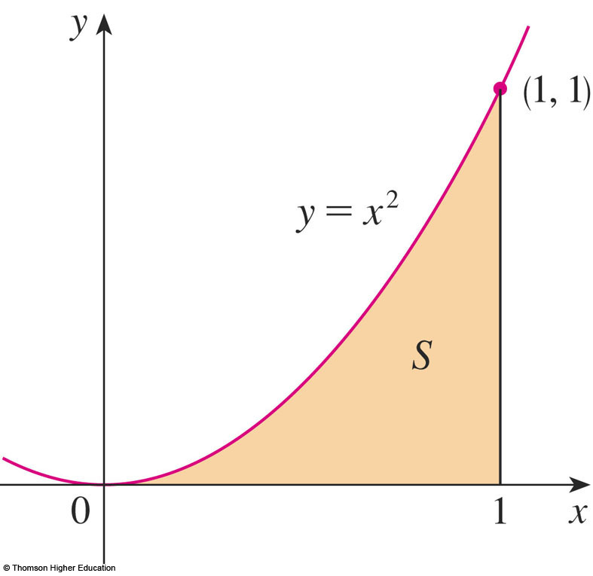
AREA PROBLEM
We begin by attempting to solve the area problem:
Find the area of the region S that lies under the curve y = f(x) from a to b.

Slide 5
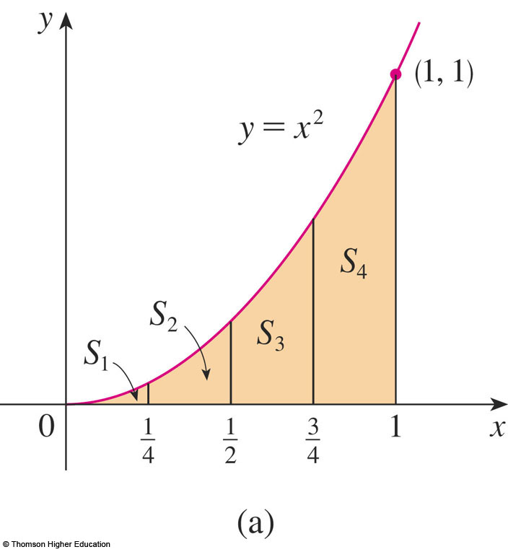
AREA PROBLEM
Example 1
Suppose we divide S into four strips S₁, S₂, S₃, and S₄ by drawing the vertical lines x = ¼, x = ½, and
x = ¾.

Slide 6
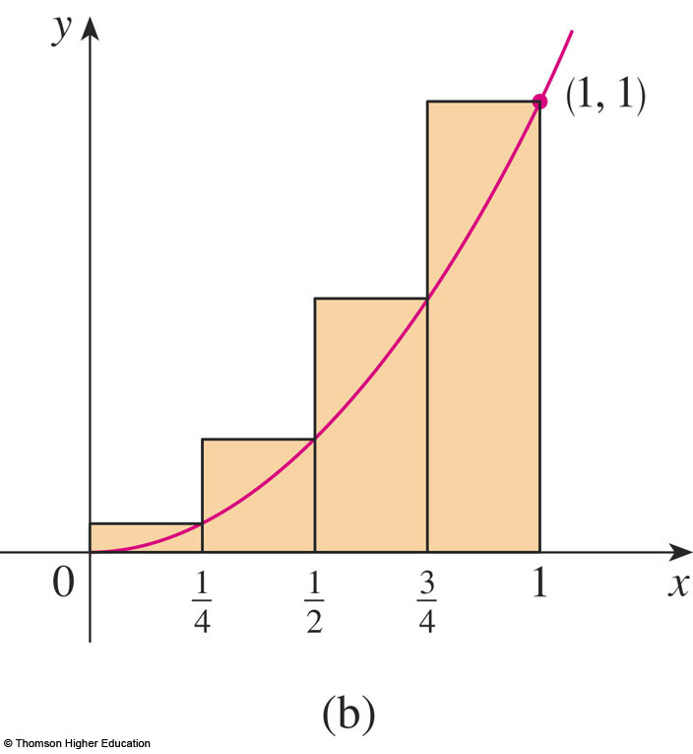
AREA PROBLEM
Example 1
The heights of these rectangles are the values of the function f(x) = x² at the right endpoints of the subintervals
[0, ¼],[¼, ½], [½, ¾],
and [¾, 1].

Slide 7
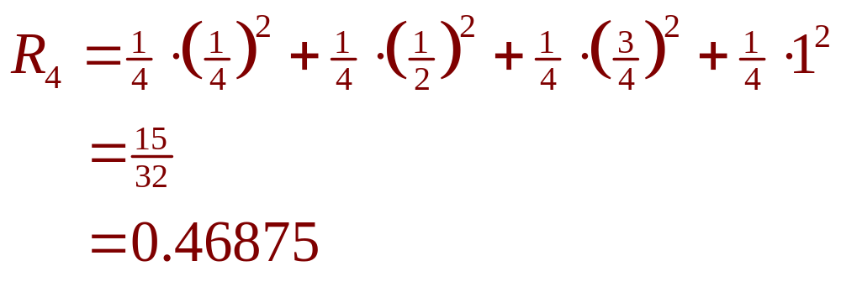
AREA PROBLEM
Example 1
Each rectangle has width ¼ and the heights are (¼)², (½)², (¾)², and 1².

Slide 8
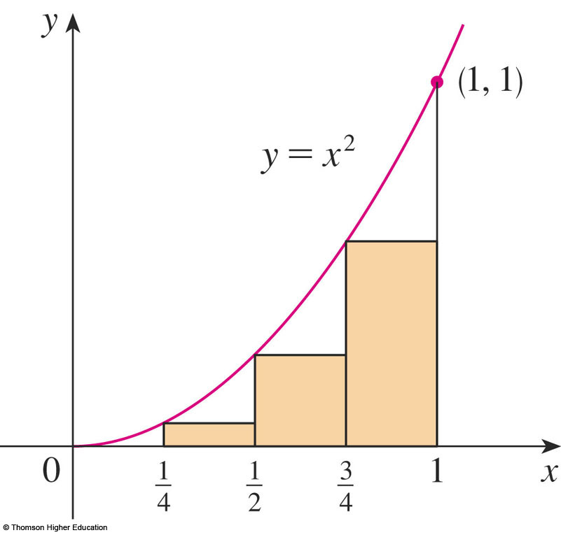
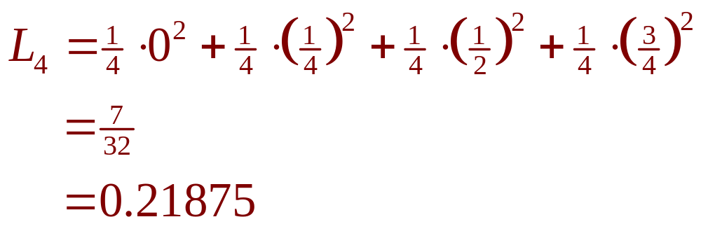
AREA PROBLEM
Example 1
Here, the heights are the values of f at the left endpoints of the subintervals.

Slide 9
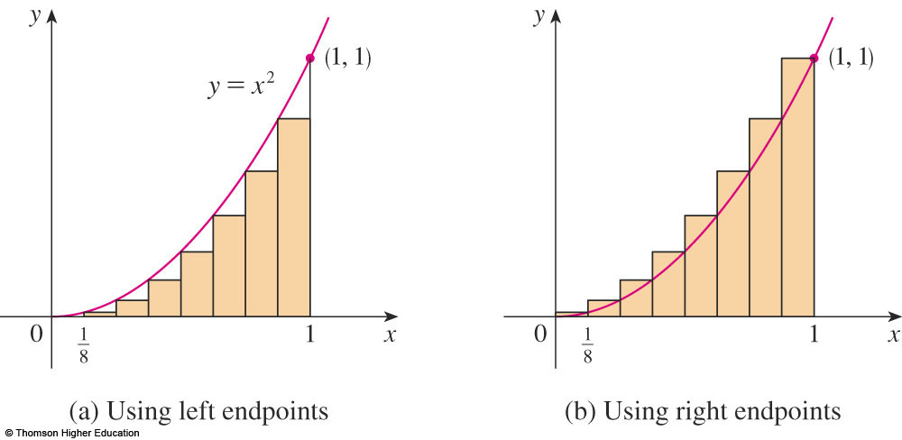
AREA PROBLEM
Example 1
The figure shows what happens when we divide the region S into eight strips of equal width.
0.2734375 < A < 0.3984375

Slide 10
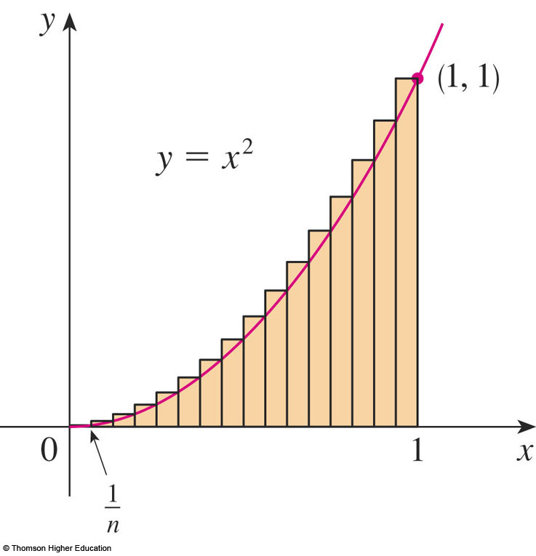
AREA PROBLEM
Example 2
R_{n} is the sum of the areas of the n rectangles.
  Each rectangle has width
  1/n and the heights are
  the values of the function
  f(x) = x² at the points
  1/n, 2/n, 3/n, …, n/n.
  That is, the heights are
  (1/n)², (2/n)², (3/n)², …,
  (n/n)².

Slide 11
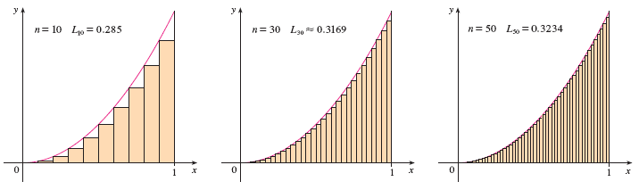
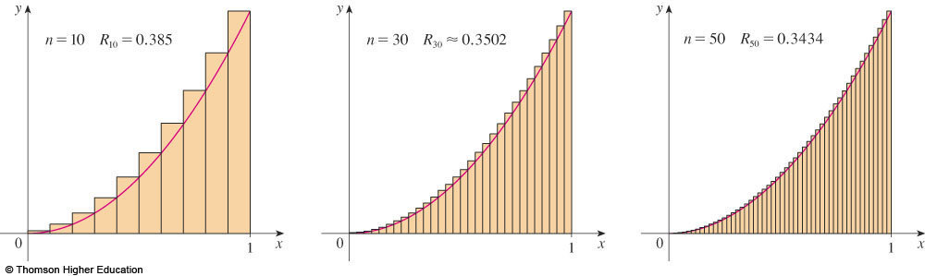
AREA PROBLEM
© Thomson Higher Education

Slide 12
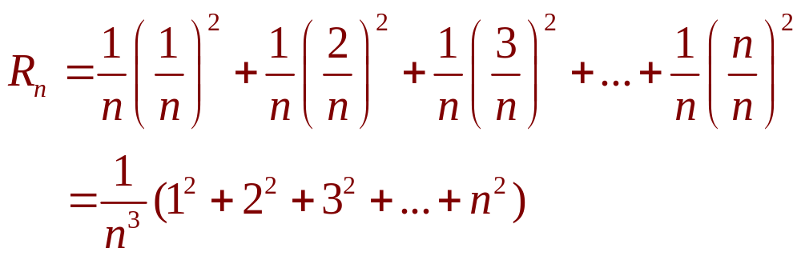
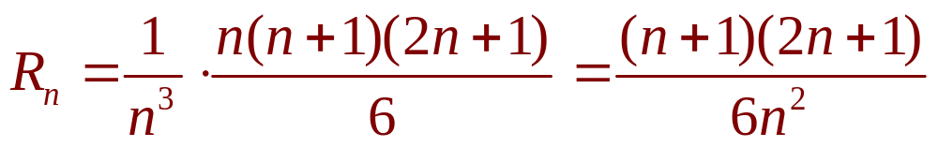
AREA PROBLEM
Example 2
Thus,

Slide 13
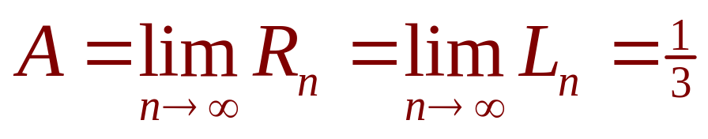
AREA PROBLEM
Thus, we define the area A to be the limit of the sums of the areas of the approximating rectangles, that is,

Slide 14
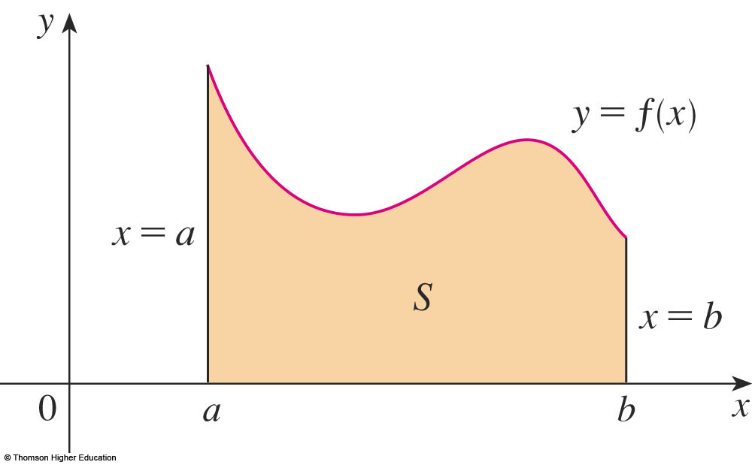
AREA PROBLEM
Let’s apply the idea of Examples 1 and 2
to the more general region S of the earlier figure.

Slide 15
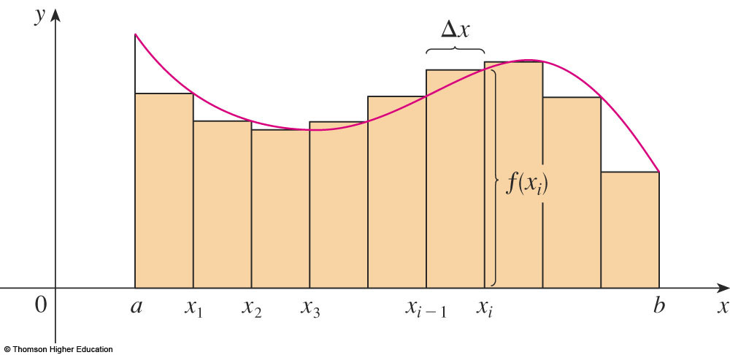
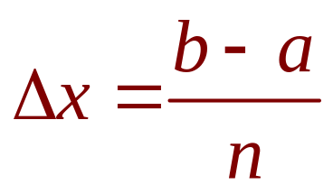
AREA PROBLEM
What we think of intuitively as the area of S is approximated by the sum of the areas of these rectangles:
R_{n} = f(x₁) ∆x + f(x₂) ∆x + … + f(x_{n}) ∆x

Slide 16
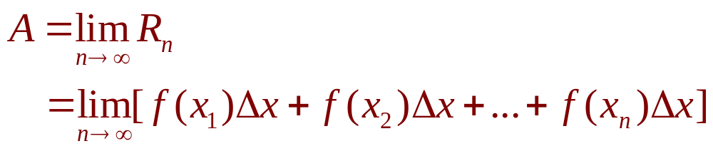
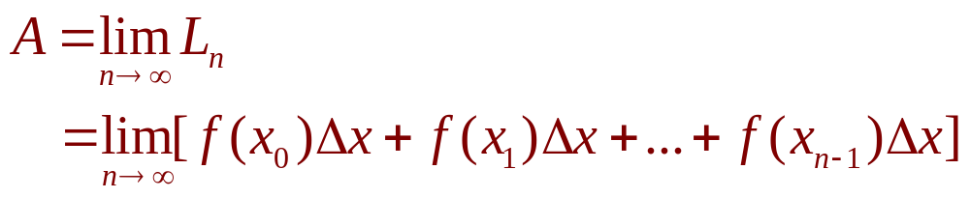
AREA PROBLEM
Definition 2
The area A of the region S that lies under the graph of the continuous function f is the limit of the sum of the areas of approximating rectangles:

Slide 17
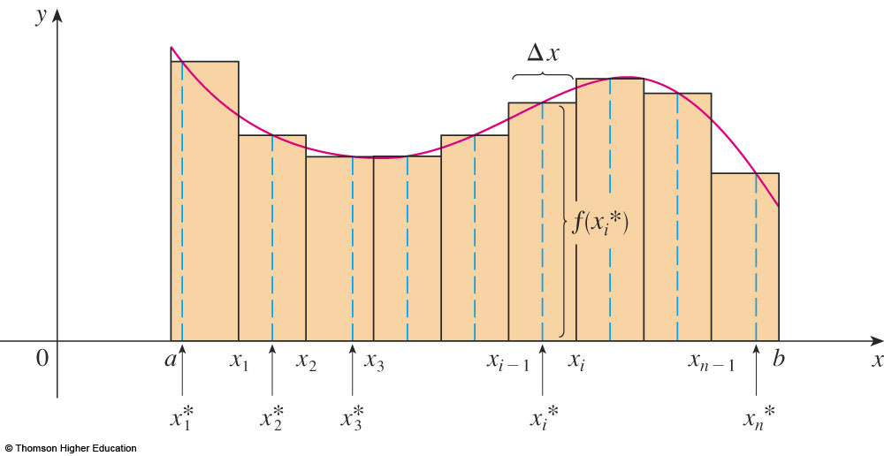
AREA PROBLEM
The figure shows approximating rectangles when the sample points are not chosen to be endpoints.
x_{i}* in the i ^{th} subinterval [x_{i - 1}, x_{i}]
(the sample points)
Notes:
The sample point such as left end point, right end point and midpoint.

Slide 18
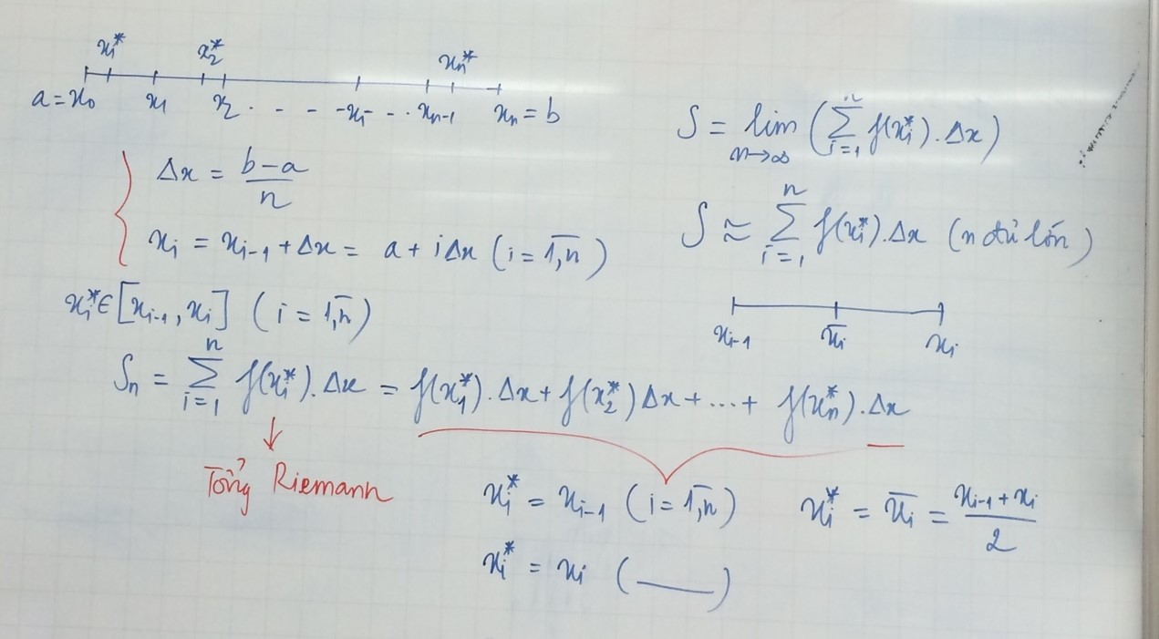

Slide 19
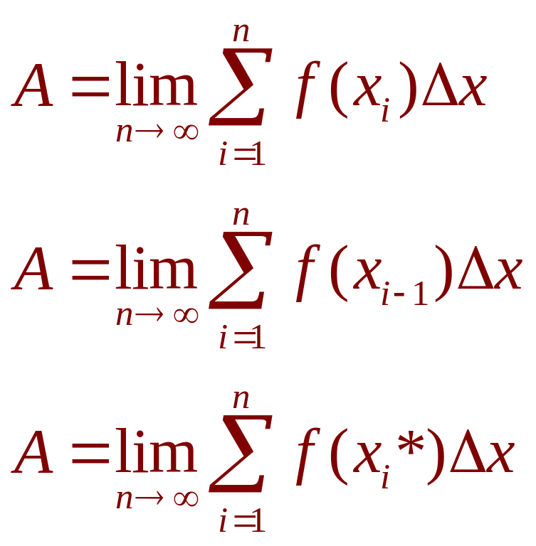
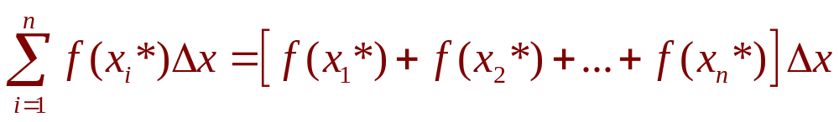
AREA PROBLEM
Hence,
The sum
is called a Riemann sum.

Slide 20
Evaluating the Riemann sum of the function f(x)= x-1/x (1<=x<=2) ,
with four subintervals. The sample points are the right endpoints.
Answer:

Slide 21
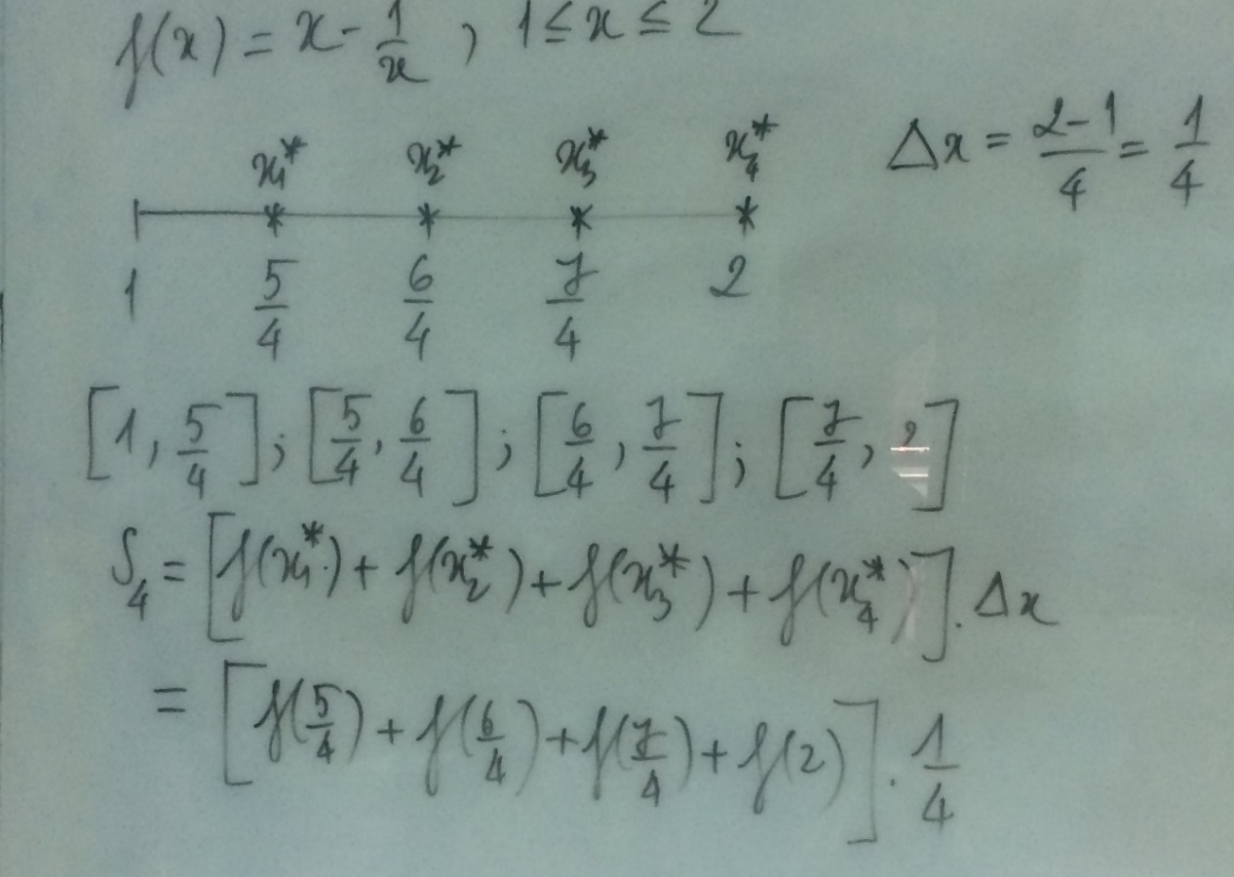

Slide 22
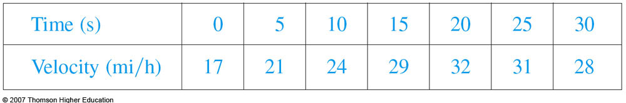
DISTANCE PROBLEM
Example 4
Suppose the odometer on our car is broken and we want to estimate the distance driven over a 30-second time interval.
We take speedometer readings every five seconds and record them in this table.
Notes:
Actual distance traveled by approximating the area under the velocity curve.

Slide 23
DISTANCE PROBLEM
Example 4
If we take the velocity during that time interval to be the initial velocity (25 ft/s), then we obtain the approximate distance traveled during the first five seconds:
25 ft/s x 5 s = 125 ft

Slide 24
DISTANCE PROBLEM
Example 4
If we had wanted a more accurate estimate, we could have taken velocity readings every two seconds, or even every second.

Slide 25
DISTANCE PROBLEM
In general, suppose an object moves with velocity
v = f(t)
where a ≤ t ≤ b and f(t) ≥ 0.
We take velocity readings at times
t₀(= a), t₁, t₂, …., t_{n}(= b)
so that the velocity is approximately constant on each subinterval.
  ∆t = (b – a)/n

Slide 26
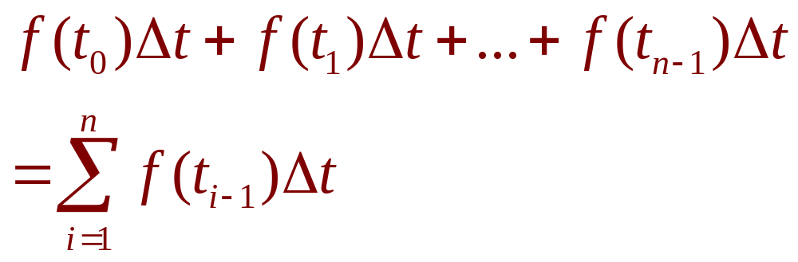
DISTANCE PROBLEM
Similarly, the distance traveled during the second time interval is about f(t₁)∆t and the total distance traveled during the time interval [a, b] is approximately

Slide 27
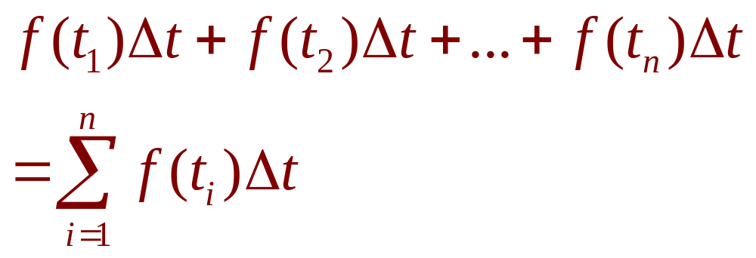
DISTANCE PROBLEM
If we use the velocity at right endpoints instead of left endpoints, our estimate for the total distance becomes:

Slide 28
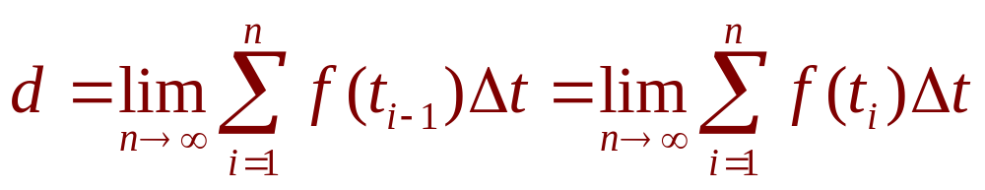
DISTANCE PROBLEM
Equation 5
So, it seems plausible that the exact distance d traveled is the limit of such expressions:
  We will see in Section 4.4 that this is indeed true.

Slide 29
INTEGRALS
4.2&4.3
The Definite Integral
In this section, we will learn about:
Integrals with limits that represent
a definite quantity.
Notes:
The precise definition of a definite integral.
The definition of an integrable function.
The concept of “area” and “signed area”.

Slide 30
DEFINITE INTEGRAL
Definition 2
If f is a function defined for a ≤ x ≤ b,
we divide the interval [a, b] into n subintervals of equal width ∆x = (b – a)/n.
  We let x₀(= a), x₁, x₂, …, x_{n}(= b) be the endpoints
  of these subintervals.
  We let x₁*, x₂*,…., x_{n}* be any sample points in
  these subintervals, so x_{i}* lies in the i ^{th} subinterval.

Slide 31
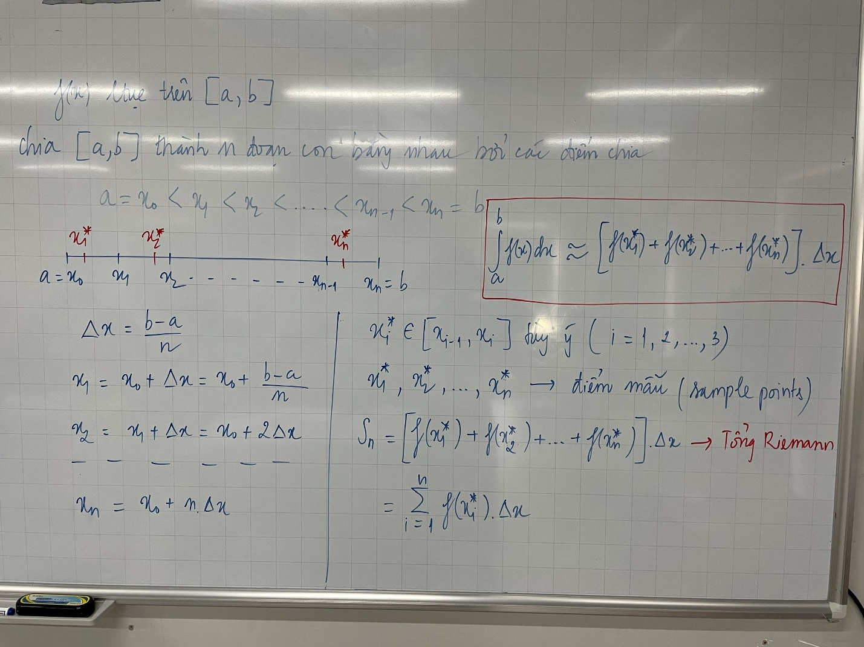

Slide 32
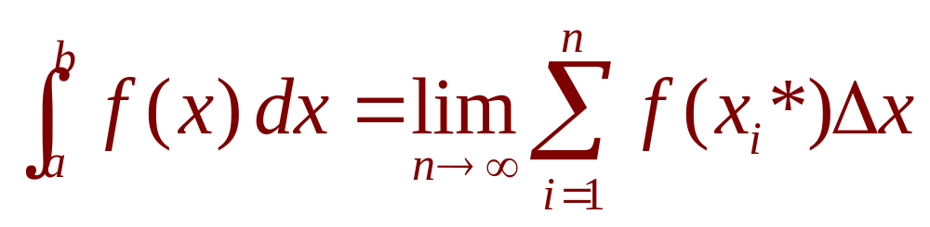
DEFINITE INTEGRAL
Definition 2
Then, the definite integral of f from a to b is
provided that this limit exists.
☞ If it does exist, we say f is integrable on [a, b].
☞ The symbol ∫ was introduced by Leibniz and is called an integral sign.

Slide 33
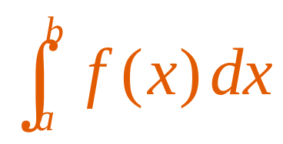
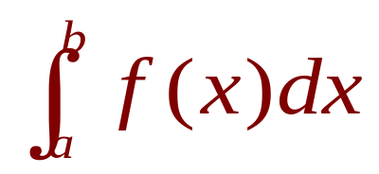
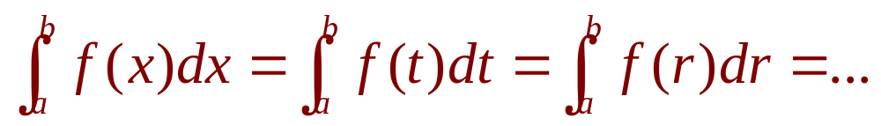
DEFINITE INTEGRAL
Note 2
The definite integral is a number.
It does not depend on x.
In fact, we could use any letter in place of x without changing the value of the integral:

Slide 34
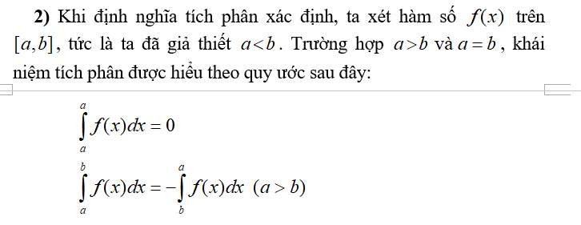

Slide 35
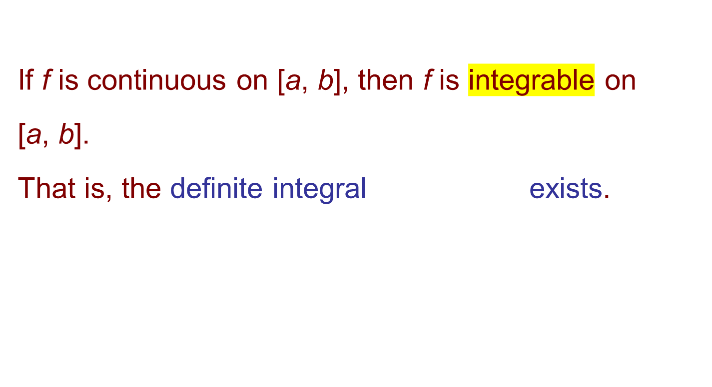
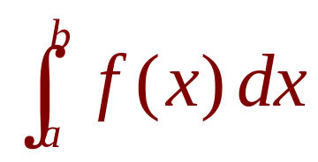
INTEGRABLE FUNCTIONS
Theorem 3

Slide 36
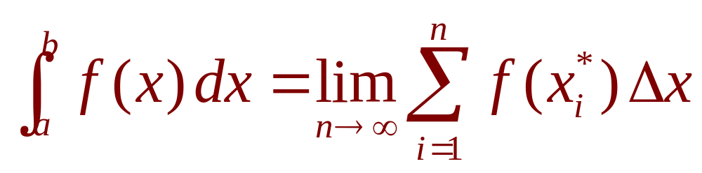
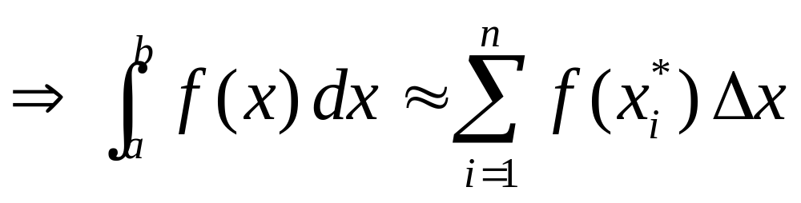
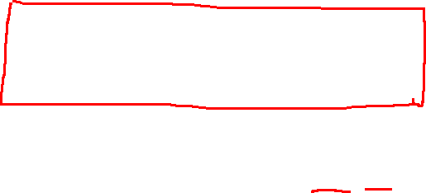
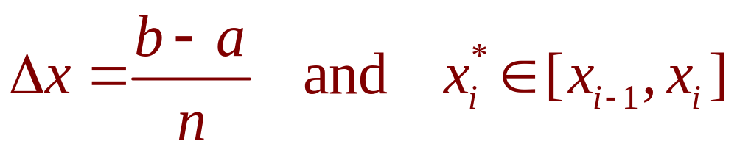

INTEGRABLE FUNCTIONS
Theorem 4
If f is integrable on [a, b], then
where

Slide 37
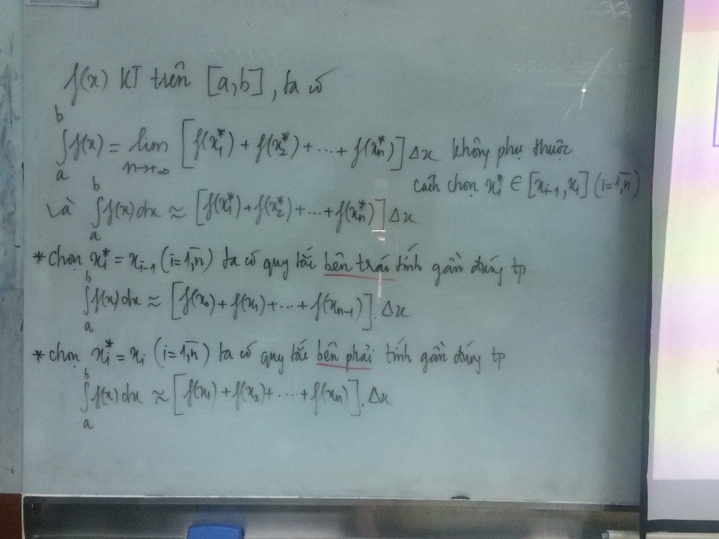

Slide 38
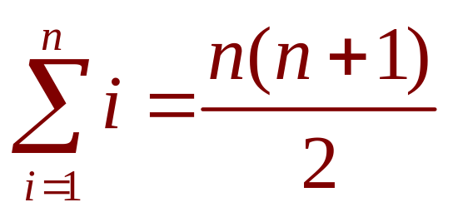
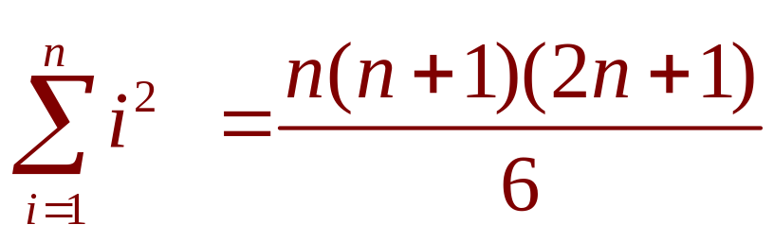
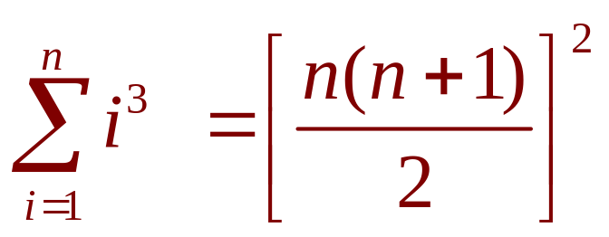
EVALUATING INTEGRALS
Equation 5,6,7
The following three equations give formulas for sums of powers of positive integers.

Slide 39
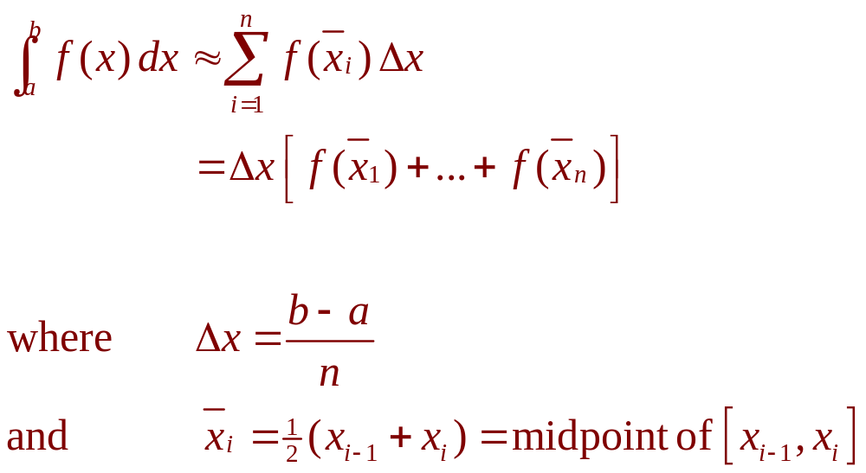
THE MIDPOINT RULE
Notes:
Riemann sum

Slide 40
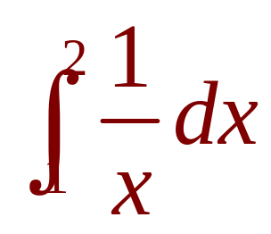
MIDPOINT RULE
Example 5
Use the Midpoint Rule with n = 5
to approximate
  The endpoints of the five subintervals
  are: 1.0, 1.2, 1.4, 1.6, 1.8, 2.0
  [1, 1.2], [1.2 , 1.4], [1.4 , 1.6], [1.6, 1.8], [1.8 , 2]
  So, the midpoints are: 1.1, 1.3, 1.5, 1.7, 1.9

Slide 41
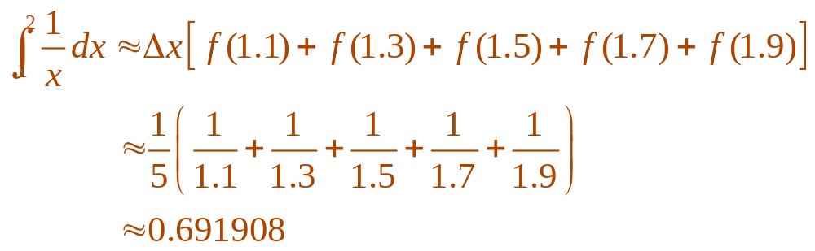
MIDPOINT RULE
Example 5
  The width of the subintervals is:
  ∆x = (2 - 1)/5 = 1/5
  So, the Midpoint Rule gives:

Slide 42
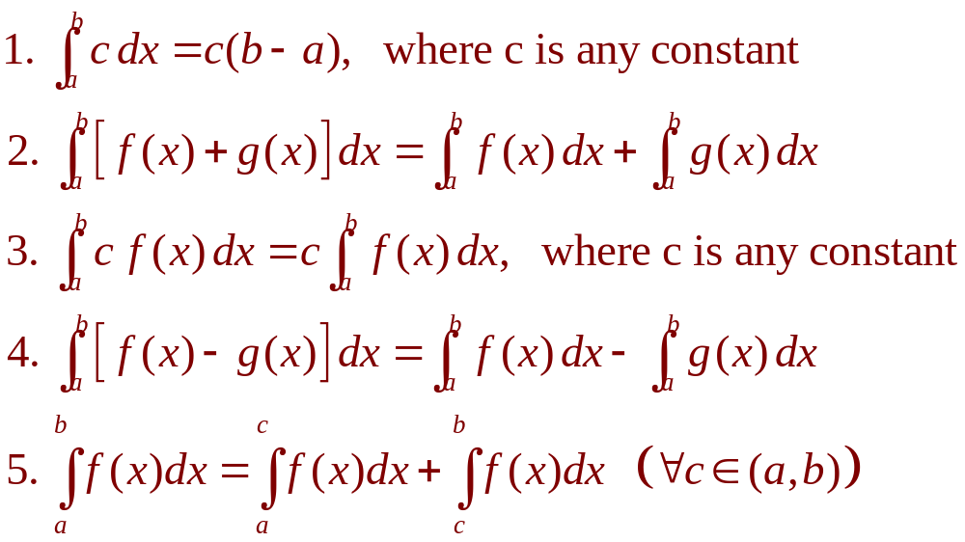
PROPERTIES OF THE INTEGRAL
We assume f and g are continuous functions.

Slide 43
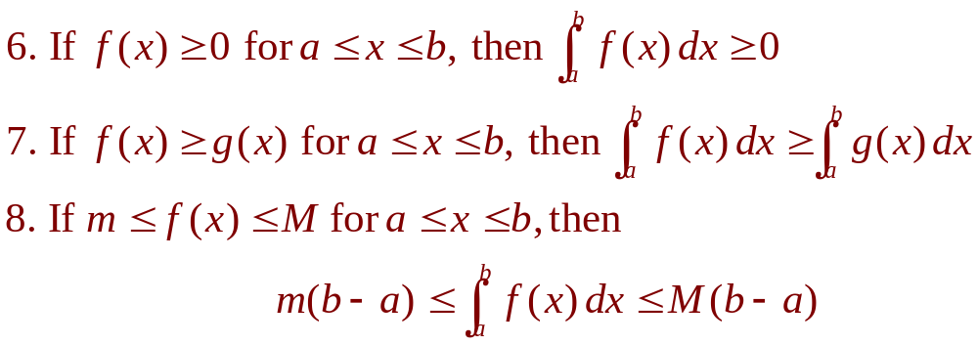
COMPARISON PROPERTIES OF THE INTEGRAL
These properties, in which we compare sizes of functions and sizes of integrals, are true only if a ≤ b.
Notes:
The geometric and comparison properties of definite integrals, developed as statements about area.

Slide 44
INTEGRALS
4.4
The Fundamental
Theorem of Calculus
In this section, we will learn about:
The Fundamental Theorem of Calculus
and its significance.
Notes:
Precise interpretations of both parts of the Fundamental Theorem of Calculus (FTC1 and FTC2).
When FTC2 can be used.

Slide 45
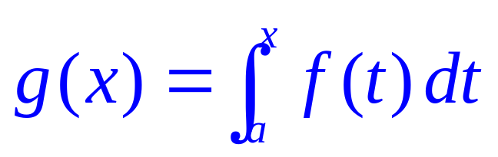
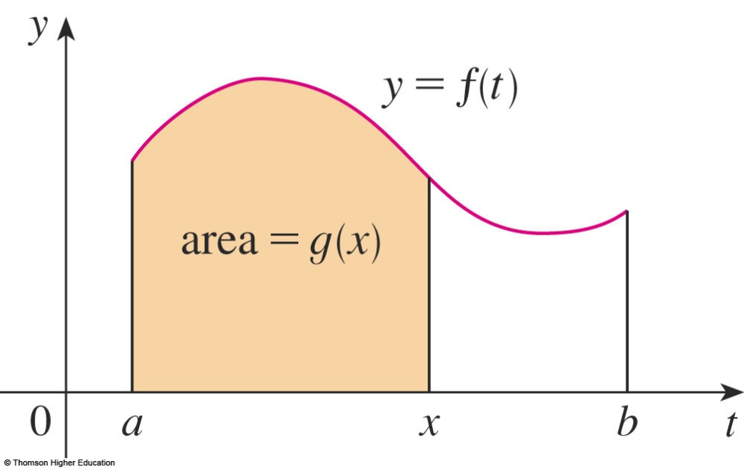
FTC
Equation 1
The first part of the FTC deals with functions defined by an equation of the form:
where f is a continuous function on [a, b] and x varies between a and b.
Notes:
The right-hand side is a function of x and not t.

Slide 46


FTC
To see why this might be generally true, we consider a continuous function f with f(x) ≥ 0.
  Then, can be interpreted as
  the area under the graph of f from a to x.

Slide 47

FTC
To compute g’(x) from the definition of derivative, we first observe that, for h > 0,
g(x + h) – g(x) is obtained by subtracting areas.
  It is the area
  under the graph
  of f from x to x + h
  (the gold area).

Slide 48


FTC
For small h, you can see that this area is approximately equal to the area of the rectangle with height f(x) and width h:
So,

Slide 49


FTC1
If f is continuous on [a, b], then the function g defined by
is continuous on [a, b] and differentiable on (a, b), and g’(x) = f(x).
Using Leibniz notation for derivatives, we can write the FTC1 as
when f is continuous.
Notes:
For every a, g(x) is an anti derivative if f.

Slide 50





Generalization
liên tục và có đạo hàm trên (a, b)
liên tục

Slide 51



If
Find g’(x)

Slide 52


FTC2
If f is continuous on [a, b], then
where F is any antiderivative of f, that is, a function such that F’ = f.
Notes:
The right-hand side is a constant.

Slide 53


Slide 54


NET CHANGE THEOREM
So, we can reformulate
as follows.
The integral of a rate of change is the net change:

Slide 55

NET CHANGE THEOREM
If the mass of a rod measured from the left end to a point x is m(x), then the linear density is ρ(x) = m’(x).
  So,
  is the mass of the segment of the rod
  that lies between x = a and x = b.
Notes:
The interpretation of the Fundamental Theorem of Calculus 2 as the total change of a rate fuction.

Slide 56

NET CHANGE THEOREM
If the rate of growth of a population is dn/dt, then
is the net change in population during the time period from t₁ to t₂.
  The population increases when births happen
  and decreases when deaths occur.
  The net change takes into account both births
  and deaths.

Slide 57



NET CHANGE THEOREM
Equation 2

Slide 58


NET CHANGE THEOREM
Equation 3
In both cases, the distance is computed by integrating |v(t)|, the speed.
Therefore,

Slide 59
NET CHANGE THEOREM
If we want to calculate the distance the object travels during that time interval, we have to consider the intervals when:
  v(t) ≥ 0 (the particle moves to the right)
  v(t) ≤ 0 (the particle moves to the left)

Slide 60

NET CHANGE THEOREM
The figure shows how both displacement and distance traveled can be interpreted in terms of areas under a velocity curve.
Notes:
displacement ≠ distance

Slide 61

NET CHANGE THEOREM
The acceleration of the object is
a(t) = v’(t).
  So,
  is the change in velocity from time t₁ to time t₂.

Slide 62
NET CHANGE THEOREM
Example 6
A particle moves along a line so that its velocity at time t is:
v(t) = t² – t – 6 (in meters per second)
  Find the displacement of the particle during
  the time period 1 ≤ t ≤ 4.
  Find the distance traveled during this time period.

Slide 63


NET CHANGE THEOREM
Example 6 a
By Equation 2, the displacement is:
  This means that the particle moved 4.5 m
  toward the left.

Slide 64

NET CHANGE THEOREM
Example 6 b
Note that
v(t) = t² – t – 6 = (t – 3)(t + 2)
  Thus,
  v(t) ≤ 0 on the interval [1, 3] and v(t) ≥ 0 on [3, 4]

Slide 65


NET CHANGE THEOREM
Example 6 b
So, from Equation 3, the distance traveled is:

Slide 66


MEAN VALUE THEOREM
The geometric interpretation of the Mean Value Theorem for Integrals is as follows.
  For ‘positive’ functions f, there is a number c such that the rectangle with base [a, b] and height f(c) has the same area as the region under the graph of f from a to b.

Slide 67



MEAN VALUE THEOREM
If f is continuous on [a, b], then there exists a number c in [a, b] such that
that is,

Slide 68

Find the average value of the function
f(x)=x²+3 on the interval [2,5]

Slide 69
INDEFINITE INTEGRAL
Due to the relation given by the FTC between antiderivatives and integrals, the notation ∫ f(x) dx is traditionally used for an antiderivative of f and is called an indefinite integral.
Thus, ∫f(x) dx = F(x) + C means F’(x) = f(x)
Notes:
How they differ from definite integrals. The representation of an indefinite integral as a family of function.
How to quantitatively recover f from f’.

Slide 70

INDEFINITE VS. DEFINITE INTEGRALS
You should distinguish carefully between definite and indefinite integrals.
  A definite integral is a number.
  An indefinite integral ∫f(x)dx is a function
  (or family of functions).

Slide 71

TABLE OF INDEFINITE INTEGRALS
Table 1
Notes:
Requiring that this table be memorized.

Slide 72
INTEGRALS
4.5
The Substitution Rule
In this section, we will learn:
To substitute a new variable in place of an existing
expression in a function, making integration easier.
Notes:
When we use the substitution rule and how it is used.
During the lecture for this section, show Table 1 on the board

Slide 73
SUBSTITUTION RULE
Equation 4
If u = g(x) is a differentiable function whose range is an interval I and f is continuous on I, then
∫ f(g(x))g’(x) dx = ∫ f(u) du

Slide 74

INTRODUCTION
Equation 1
However, our antidifferentiation formulas don’t tell us how to evaluate integrals such as

Slide 75

SUBSTITUTION RULE
Example
Find ∫ x³ cos(x⁴ + 2) dx
  We make the substitution u = x⁴ + 2.
  This is because its differential is du = 4x³ dx,
  which, apart from the constant factor 4,
  occurs in the integral.

Slide 76

SUBSTITUTION RULE
Example
Thus, using x³ dx = du/4 and the Substitution Rule, we have:
  Notice that, at the final stage, we had to return to
  the original variable x.

Slide 77


Slide 78


SUB. RULE FOR DEF. INTEGRALS
Example 7
Evaluate
  Let u = 3 – 5x.
  Then, du = –5dx, so dx = –du/5.
  When x = 1, u = –2, and when x = 2, u = –7.

Slide 79

SUB. RULE FOR DEF. INTEGRALS
Equation 5
If g’ is continuous on [a, b] and f is continuous on the range of u = g(x), then
Let F be an antiderivative of f.
Then, F(g(x)) is an antiderivative of f(g(x))g’(x).
So,

Slide 80


INTEGS. OF SYMM. FUNCTIONS
Theorem 6
Suppose f is continuous on [–a , a].
If f is even, [f(–x) = f(x)], then
If f is odd, [f(-x) = -f(x)], then

Slide 81

INTEGS. OF SYMM. FUNCTIONS
Theorem 6 is
illustrated here.

Slide 82
Suppose that the animal population is
increasing at a rate f(t)=3t-1 ( t measured in years).
How much does the animals increase
between the third and the seven years?
Notes:
Use FTC2

Slide 83
Suppose the acceleration function and initial velocity are
a(t)=t+3 (m/s²), v(0)=5 (m/s).Find the velocity at
time t and the distance traveled when 0<=t<=5
Answer:
Notes:
Use FTC2

Slide 84
Exercises
2a; 3; 4 p203 11,12 p 204
1,2 p215 8, 9, 13,14 p216
Example 7 p223
55,56,57,58 p226
5,8,9,10;19; 20 p234
4, 40, 12, 13,52 p241,242 23,24 p244

Slide 85
Thanks

